Slide 1
HRvatsko asfaltersko društvo Cold In situ recycling and very thin asphalt concrete - French technology JP Michaut Seminar ASFALTNI KOLNICI 2015 Opatija, 05. – 06. 03. 2015

Slide 2
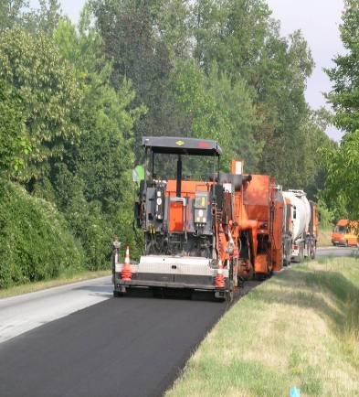
Novacol cold in situ recycling
NOVACOL from 1986
More than 25 years
More than 6,000,000m²
In different countries

Slide 3
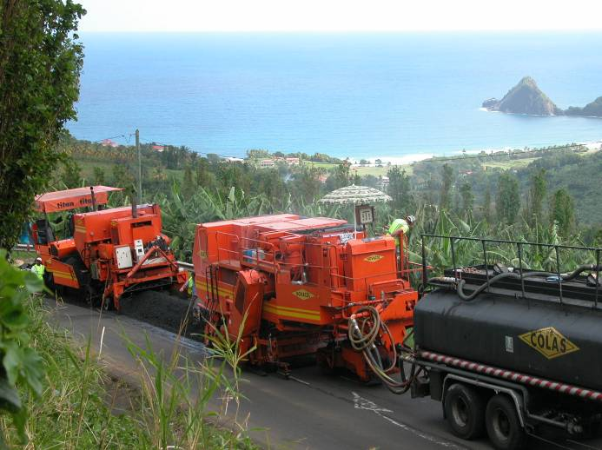
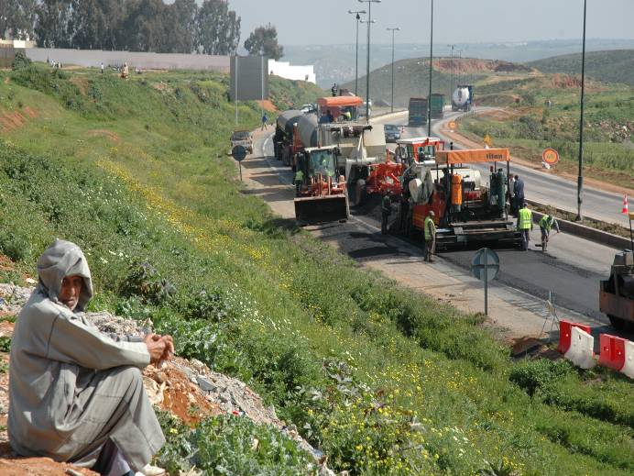
What is the cold in-situ recycling?
Cold in-situ recycling consists:
milling or crushing the old pavement up to 20 cm depth,
incorporate in the same time in the milled and crushed material a bituminous emulsion,
In order to stabilize the recycled layer and to give it rejuvenation and cohesion.
The mixture is laid and compacted to constitute a new binder course

Slide 4
Cold in-situ recycling workshop
ROLLER
SUPPLY TANKER
MIXER MILLING MACHINE
E COMPACTOR
(Rejuvenating emulsion)
PAVER
WINDROW ELEVATORTACK COAT
Length around 200 m only !!!

Slide 5
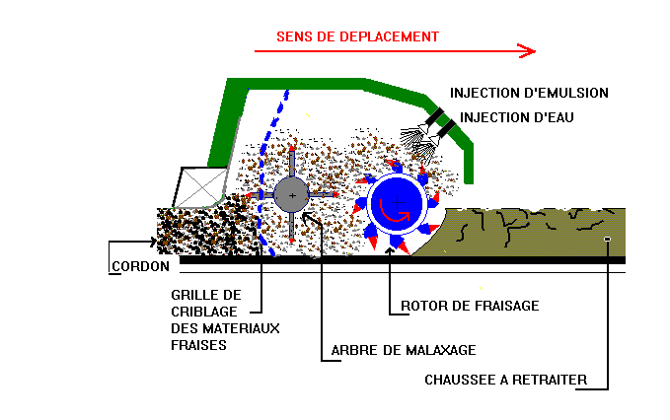
Novacol Cold in-situ recycling
PRINCIPLE

Slide 6
Cold in-situ recycling Objectives and fields
To recycle the upper bituminous layers damaged by fatigue to form a new binder or base course.
To recycle the surface layer and a few centimeters of the course of semi rigid pavement in order to restore the bonding and to reconstitute a new surfacing.
To recycle alone the bituminous wearing course to remedy surface layer problem such as cracking, excessive ageing of binder, etc.

Slide 7
Cold in-situ recycling Limits of use
Climatic condition too low
Max size < 80mm
Presence of geo textile
Presence of many services exits and manholes
Homogeneity of the old pavement

Slide 8
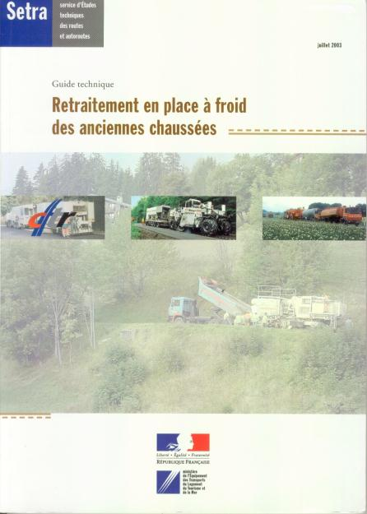
State of the art: French guide

Slide 9
Objectives and Classification
Type | Emulsion |  |  | Cement
Class | 1 | 2 | 3 | 4
Goal | Structural Reinforcement | Wearing course rehabilitation | Wearing course rehabilitation | Structural reinforcement
Existing pavement | Few cm of AC + unbound or bound base course | 4 to 8 cm of AC + unbound or bound base course | 100% of AC | AC + binder and base course
Use | Base course | Binder course | Binder course | Base course

Slide 10
Objectives and Classification
Type | Emulsion |  |  | Cement
Class | 1 | 2 | 3 | 4
Goal | Structural Reinforcement | Wearing course rehabilitation | Wearing course rehabilitation | Structural reinforcement
Use | Base course | Binder course | Binder course | Base course
Binder | Emulsion | Rejuvenating emulsion | Rejuvenating emulsion | Cement or similar
Binder content | 3 to 5 % residual binder | 1 to 3 % residual binder | Up to 2 % residual binder | 3 to 7 % hydraulic binder
Thickness | 10 to 15 cm | 5 to 12 cm | 5 to 12 cm | 20 to 30 cm

Slide 11
Cold in-situ recycling Mechanical performances
Results of Duriez test | Modulus at 15° C (MPa)
Unbound graded aggregate stabilized with emulsion (class 1): R at 14 days between 1.5 and 2.2 MPa and r/R > 0.55 R at 14 days between 2.2 and 3.3MPa and r/R > 0.55 | 1500 2500
Recycled material with emulsion including 75 to 90% of reclaimed bituminous material (class 2): R at 14 days lower than 4MPa and r/R > 0.65 R at 14 days higher than 4 MPa and r/R > 0.65 | 2000 3000
Recycled material with emulsion with more than 90% of reclaimed bituminous material (class 3): R at 14 days higher than 4 MPa and r/R >0.70 Other cases | 4000 3000
Correlation used in France between Duriez test results and estimated stiffness modulus

Slide 12
Novacol Cold in-situ recycling Preliminary studies
Field investigation (boring, deflection, visual aspect)
Characterization of the in situ materials
Feasibility of in situ recycling
Maximum size material
Old binder characteristics (Pen-R&B)

Slide 13
Novacol Cold in-situ recycling Mix design
Characterization of the material
Selection of the new binder to determine the need of rejuvenation
Binder determination according to the in situ total Asphalt concrete
Class I : 3 to 5 %
Class II : 1 to 3 %
Class III : Up to 2%
Mechanical properties: water resistance (Duriez) & Gyratory Shear Press tests (PCG)

Slide 14
Novacol Cold in-situ recycling
REJUVENATION AGEING BINDER
Target : R&B decrease from 5 to 15° C
TEST | BEFORE | AFTER
Pen at 25 °C (0,1 mm) | 5 - 11 | 15 - 22
R&B (°C) | 80 - 92 | 62 - 84

Slide 15
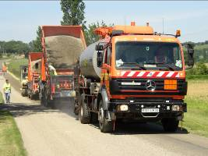
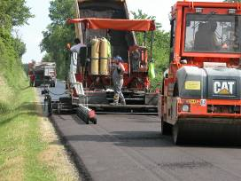
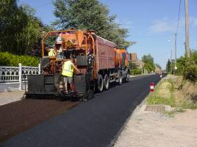
Wearing course In situ treatment
In situ recycling as binder course
Sealing coat after compaction
Wearing course is adapted to the traffic:
Surface dressing
Micro surfacing,
Thin AC
Thick AC for Heavy traffic

Slide 16
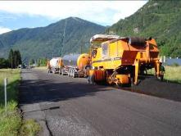
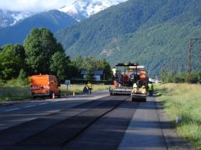
In situ recycling as wearing course
Depth from 5 to 7 cm thick
Calibrated reclaimed asphalt (milling procedure and old wearing course quality)
Special emulsion for a good coating and for rejuvenating the old binder
Binder | Before | After | Gain
Pen | 12 | 41 | 29
R&B | 70 | 56 | 14
Fraass | -2 | -11 | 9

Slide 17
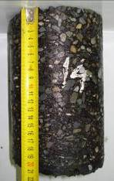
In situ recycling as wearing course
Mechanical characteristic evolution
 | 1 month | 1 year | 3 years
Pen in 1/10mm | 32 | 33 | 32
R&B in °C | 61 | 57 | 60
Fraass point in °C | -11 | -9 | -8
Density in % | 87 | 88 | 87
Stiffness in MPa | 900 | 3200 | 3000
Texture depth in mm | > 0.6 | > 0.5 | > 0.4

Slide 18
Novacol Cold in-situ recycling
Perfect bonding
BEFORE
AFTER

Slide 19
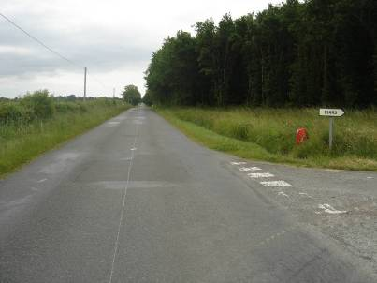
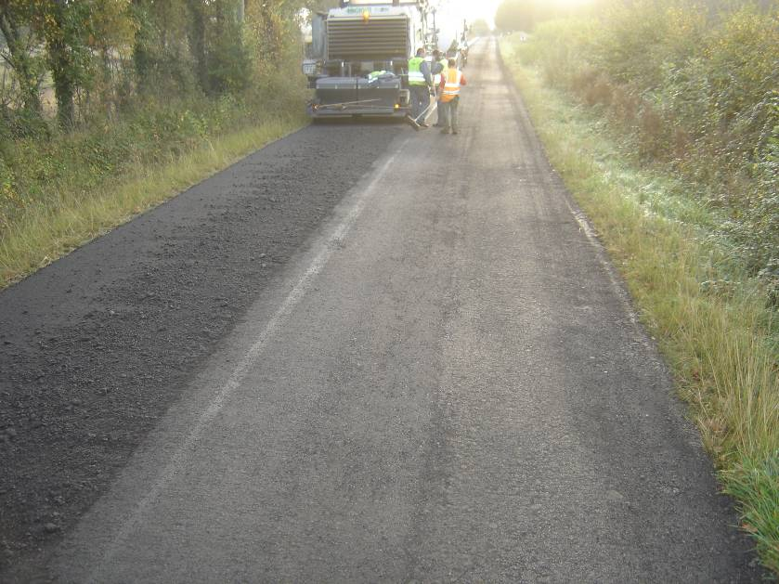
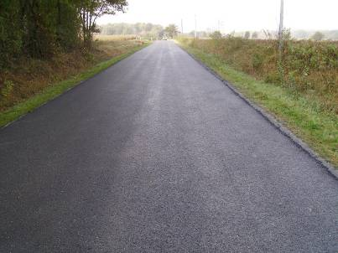
Before
During
After
19

Slide 20
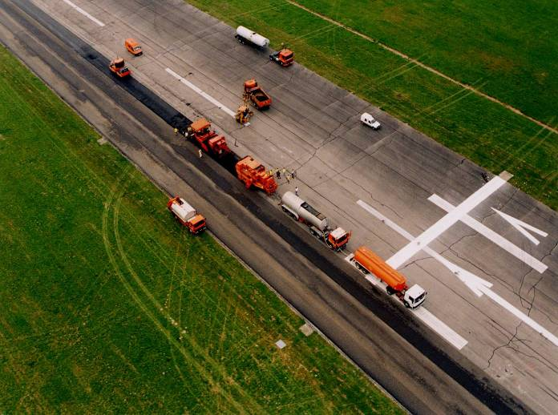
Novacol Cold in situ recycling
5 cm AC
Very good bonding
AC with asbestos
6 cm
AC
13 cm
NOVACOL
20 cm Cement material
18 cm Cement material
Limoges airport

Slide 21
Novacol typical job site in France
Structure in place:
5 cm surface course
6 cm Binder Course (AC)
The job :
In situ recycling: 8 cm depth
Rejuvenating emulsion: 2%
Wearing course : thin asphalt concrete (Ruflex) 4 cm
21

Slide 22
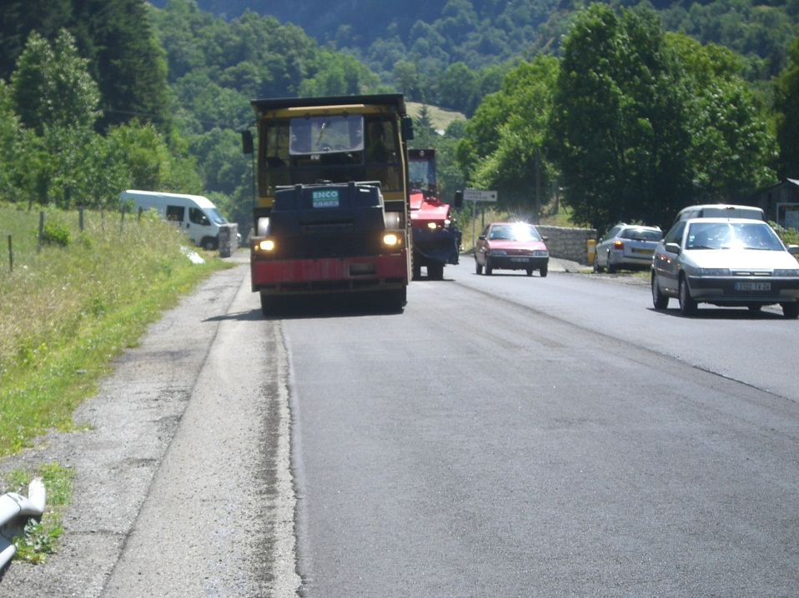
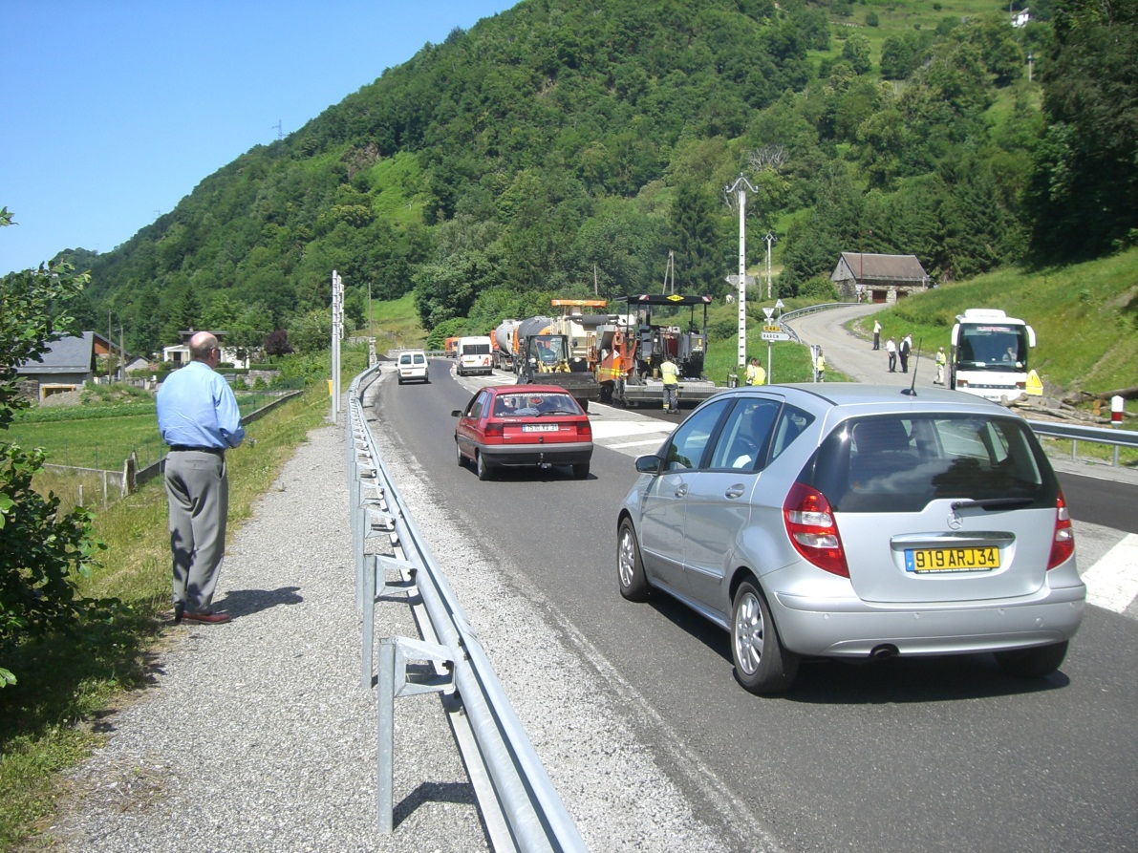
Works under traffic

Slide 23
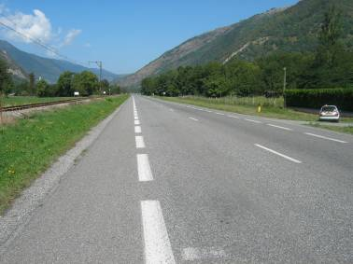
In situ multi recycling
Traffic: 150 < HGV < 300
Pavement reinforced in 2001 with:
4 cm thin AC
8 cm of in situ cold recycling with emulsion
Asphalt concrete
Unbound materials
23

Slide 24
2010 maintenance
1st section
in situ treatment: 8 cm thick
micro surfacing
2nd section
milling of the existing wearing course
In situ treatment: 8cm thick
4 cm thin AC

Slide 25
Binder characteristics
1st section: 100% of reclaimed asphalt with 2% special emulsion
2nd section: as above
 | Pen | R&B | Fraass
before | 7 | 75 | 7
after | 35 | 60 | -12
 | Pen | R&B | Fraass
before | 17 | 64 | -4
after | 38 | 53 | -11

Slide 26
Special emulsion
 |  | Before | After | Gain
Traditional emulsion | Pen | 23 | 26 | 3
 | R&B | 62 | 58 | 4
 | Fraass | -7 | -11 | 4
Special emulsion | Pen | 12 | 41 | 29
 | R&B | 70 | 56 | 14
 | Fraass | 1 | -11 | 12

Slide 27
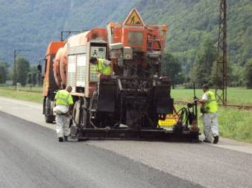
Follow-up
All cores are stuck
Density:
Traditional emulsion : 82-85%
Special emulsion : 88-92%

Slide 28
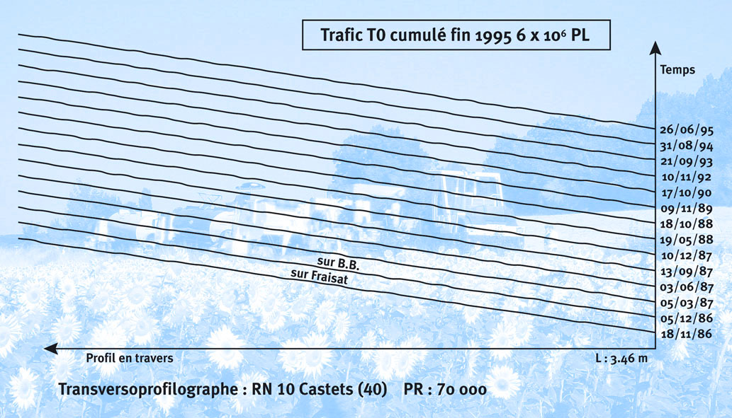
Very high rutting resistance Transversal profile
RN 10 slow lane : 20,000 vehicles / day, 16 % of HGV
after 10 years : no transversal deformation
28

Slide 29
Life cycle analysis: energy consumption for 1 m² recycled road
29

Slide 30
Life cycle analysis : GHG Emission for 1 m² recycled pavement
30

Slide 31
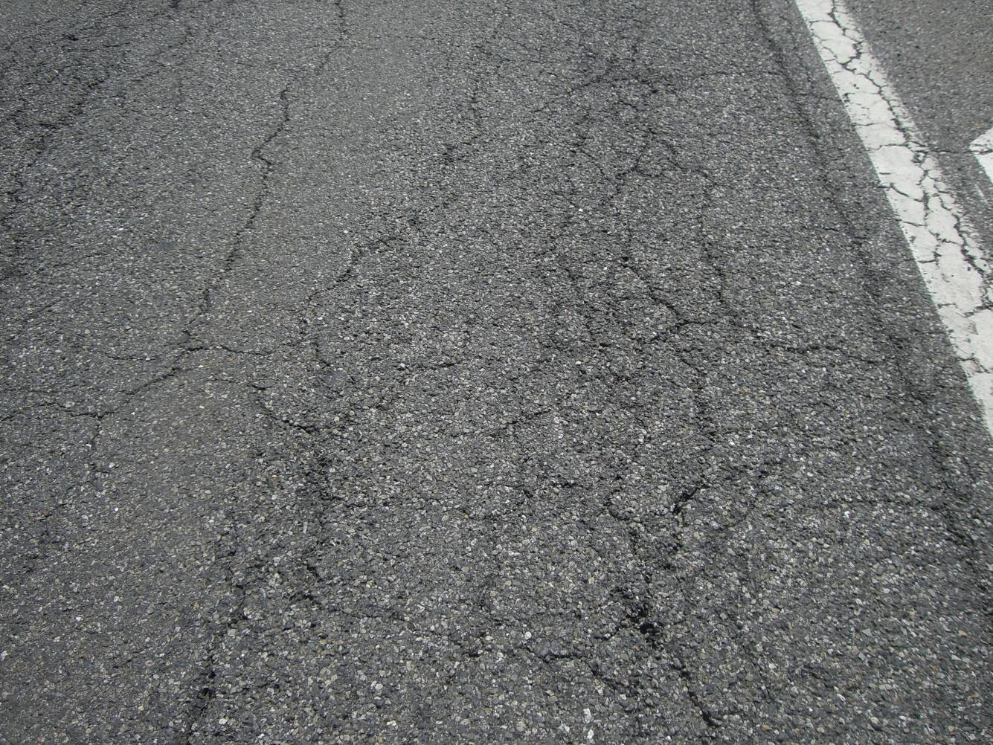
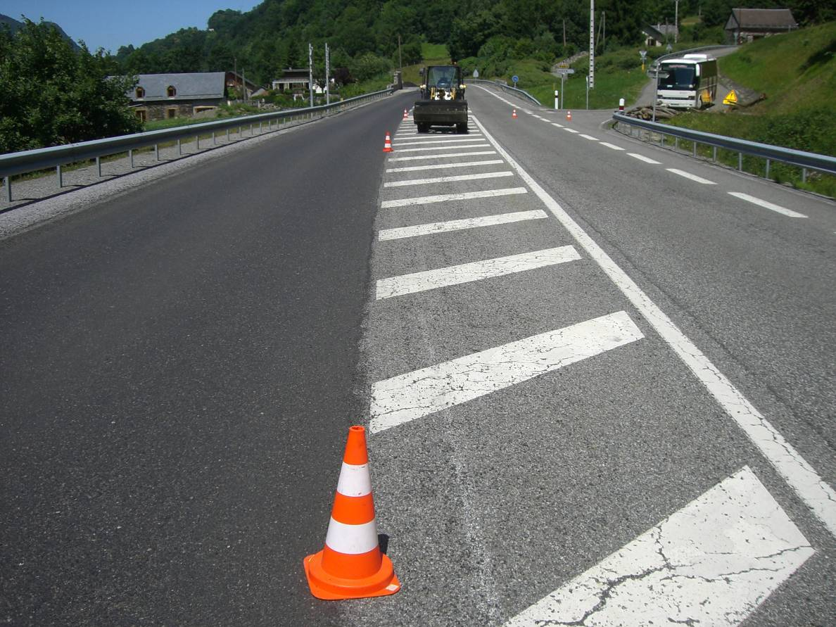
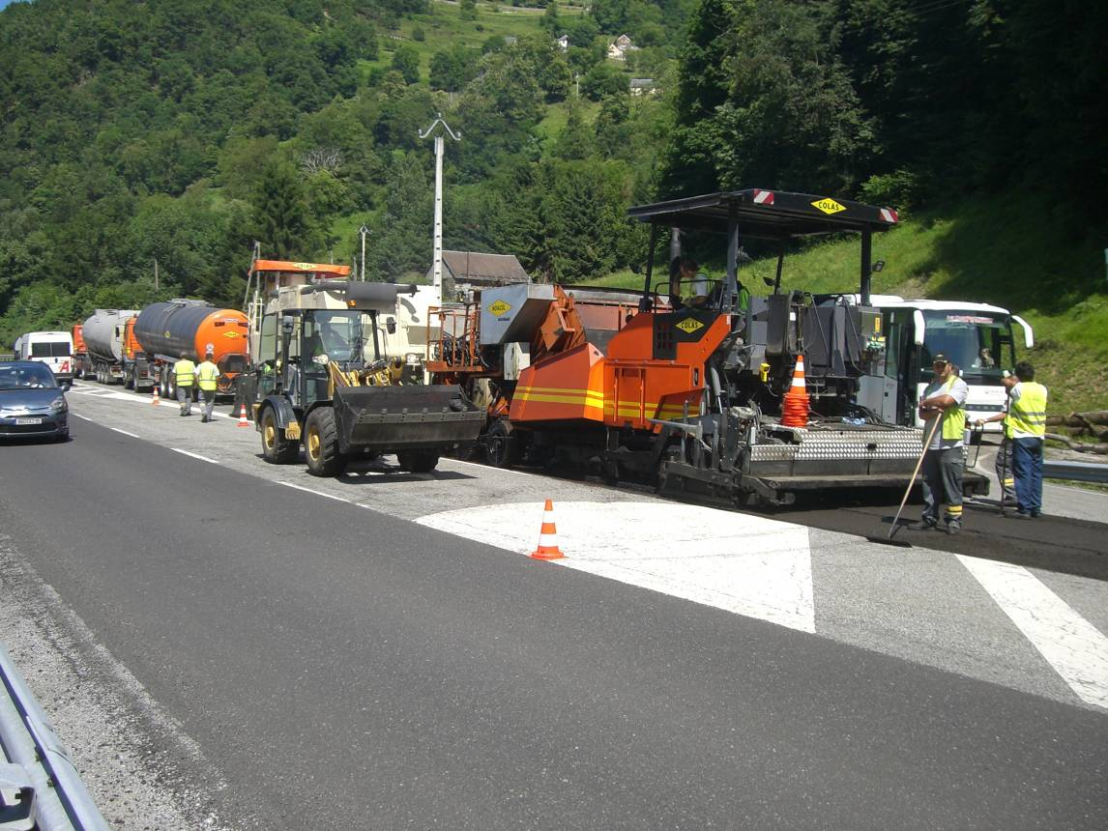
31

Slide 32
Very thin asphalt concrete BBTM
European standard 13108-2
Thickness from 20 to 30 mm
Aggregates: LA20-MDE15-PSV 50
Grading 0/6 and 0/10
Modified bitumen
Water resistance
2 classes
Class 1: void content 12/19%
Class 2: void content 20/25%
Mechanical stability (rutting test)

Slide 33
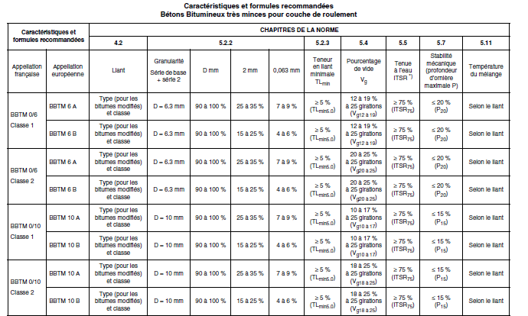
French formulations
33

Slide 34
BBTM uses
Main use
High level of skid resistance
Low rolling noise
Macro texture (Mean texture depth)
BBTM 0/6: 0.7 mm for 90%
BBTM 0/10: 0.9 mm for 90%
34

Slide 35
Longitudinal braking force coefficient
0,70
0,60
9th decile
0,50
BBTM
0,40
0,30
0,20
0,10
1st decile
Speed in km/h
0,00
40 60 80 100 120

Slide 36
BBTM uses
Existing pavement
Take care about the support
Tack coat to water proof the existing pavement
New pavement
Binder course
Take coat
36

Slide 37
Novacol Cold in-situ recycling Advantages
To save new material by the re-use of whole in place
To reduce the energy consumption
To reduce the need for transport
To limit the ancillary works (adjustment of levels, raising kerbs)
Very economic about 30% less traditional techniques
Environmental less G.E.S.
To reopen the roadway to traffic immediately
To recycle only one lane if necessary
Etc…
37

Slide 38
Conclusions
Cold in situ recycling
More than 25 years of knowledge
In situ recycling for the 2nd time
Good performances
Mechanical performance improvement
Environmental friendly technique
According to the treatment: No need of wearing course

Slide 39
Conclusions
Very thin asphalt concrete
New wearing course
Good surface characteristics (noise, skid resistance, macro texture)
Check the existing wearing course before (cracks, transversal profiles, etc.)
Take coat !!!

Slide 40
Thank you for your attention
40

